Slide 1
Tutorial 4 + Notes

Slide 2

Q1
Design a divide-and-conquer algorithm for the following problem. Analyze the times complexity for your algorithm.
Input: Two sorted integer arrays $A_{1}$ and $A_{2}$ of length $m$ and $n$ respectively.
Output: The median of $A_{1}$ combined with $A_{2}$
Example: $A_{1}=[1,2,3]$, $A_{2}=[4,5]$, and the median is $3$.

Slide 3

1st solution: Brute force
Thought process
Combine $A_{1}$ and $A_{2}$ together using Q$uickSort$.
Find the median.
Time Efficiency: $O(\left(m+n\right)log⁡(m+n))$
Space Complexity: $O(m+n)$

Slide 4

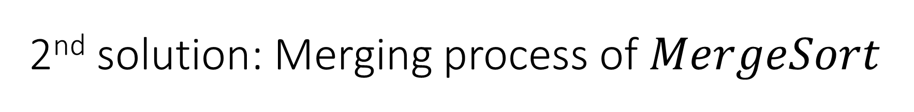
2nd solution: Merging process of $MergeSort$
Thought process
Combine $A_{1}$ and $A_{2}$ together using merging of $MergeSort$.
Find the median.
Time Efficiency: $O(m+n)$
Space Complexity: $O(m+n)$

Slide 5

3rd solution: Array partitioning method
Thought process
If $m≤n$ ($m$ represents the length of the shorter array), then the search interval is $[0,m]$, and the length of the interval will be halved after each iteration. Therefore, only $logm$ iterations are needed, so the time complexity is $O(logm)$.
Time Complexity: $O(log⁡(min⁡(m,n)))$
Space Complexity: $O(1)$

Slide 6
3rd solution: Array partitioning method
Median
In statistics, the median represents a value in a sample that divides the set of numbers into two equal parts.
Detailed method:
Use a boundary to divided the two arrays into two equal parts. If the total length is odd, make the left part have one more element.
Find the median using the boundary values.
Notes:
中位数在统计学中代表一个样本里面的一个值，其可将数值集合划分为相等的上下两部分。
解题思路： ① 用一条边界把两个数组划分为左右两个相等的部分，若总长度为奇数，则让左半部分多一个数。 ② 通过边界值去求中位数

Slide 7
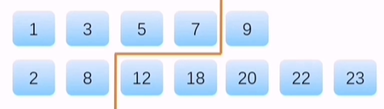
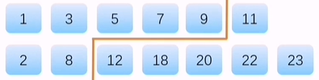














3rd solution: Array partitioning method
Determine the boundary, the upper bound $i$ and lower bound $j$. (The total length $len=m+n$)
$$i$$
$A_{1}:$
The upper bound $i$ here is 4 in $A_{1}$
If $len\%2==0:$
$A_{2}:$
The lower bound $j$ here is 2 in $A_{2}$
$$j$$
$$i$$
$A_{1}:$
The upper bound $i$ here is 5 in $A_{1}$
If $len\%2≠0:$
$A_{2}:$
The lower bound $j$ here is 2 in $A_{2}$
$$j$$
The boundary should guarantee that:
The boundary should divide the two arrays into two equal parts. If the total length is odd, let the left part have one more element.
All the values of the elements in the left part of boundary should be smaller than those in the right part.
Notes:
划分边界线必须满足① 这个边界必须把两个数组划分为左右两个相等的部分，若总长度为奇数，则让左半部分多一个数。 ② 边界线左边的元素的值都比边界线右边的元素小

Slide 8






3rd solution: Array partitioning method
Case 1: if the length of the combined array $len$ is even, then the median should be determined like following:
$$i=4$$
$A_{1}:$
The upper bound $i$ here is 4 in $A_{1}$
$A_{2}:$
The lower bound $j$ here is 2 in $A_{2}$
$$j=2$$
If $len\%2==0$, then $median=\frac{leftMax+rightMin}{2}=\frac{\max\left(A_{1}[i−1],A_{2}[j−1\right)+\min\left(A_{1}[i],A_{2}[j]\right)}{2}$
(中位数即为左边最大值和右边最小值的平均值)
Notes:
中位数在统计学中代表一个样本里面的一个值，其可将数值集合划分为相等的上下两部分。
解题思路： ① 用一条边界把两个数组划分为左右两个相等的部分，若总长度为奇数，则让左半部分多一个数。 ② 通过边界值去求中位数

Slide 9
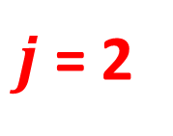






3rd solution: Array partitioning method
Case 2: if the length of the combined array $len$ is odd, then the median should be determined like following:
$$i=5$$
$A_{1}:$
The upper bound $i$ here is 5 in $A_{1}$
If $len\%2≠0:$
$A_{2}:$
The lower bound $j$ here is 2 in $A_{2}$
$j$= 2
If $len\%2≠0$, then $median=leftMax=max⁡\left(A_{1}[i−1],A_{2}[j−1]\right)$(中位数即为左边最大值)
Notes:
中位数在统计学中代表一个样本里面的一个值，其可将数值集合划分为相等的上下两部分。
解题思路： ① 用一条边界把两个数组划分为左右两个相等的部分，若总长度为奇数，则让左半部分多一个数。 ② 通过边界值去求中位数

Slide 10
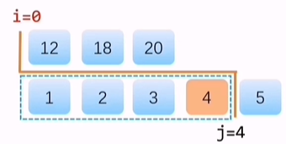
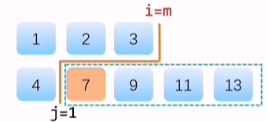
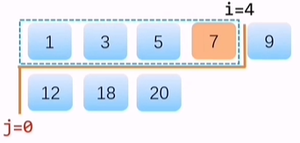
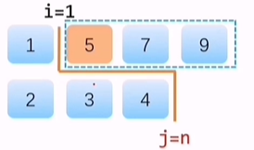












3rd solution: Array partitioning method
Some special cases:
$A_{1}:$
$A_{1}:$
$A_{2}:$
$A_{2}:$
(1) If $i==0$, then $leftMax=A_{2}[j−1]$
(2) If $i==m$, then $rightMin=A_{2}[j]$
$A_{1}:$
$A_{1}:$
$A_{2}:$
$A_{2}:$
(3) If $j==0$, then $leftMax=A_{1}[i−1]$
(4) If $j==n$, then $rightMin=A_{1}[i]$
Notes:
中位数在统计学中代表一个样本里面的一个值，其可将数值集合划分为相等的上下两部分。
解题思路： ① 用一条边界把两个数组划分为左右两个相等的部分，若总长度为奇数，则让左半部分多一个数。 ② 通过边界值去求中位数

Slide 11

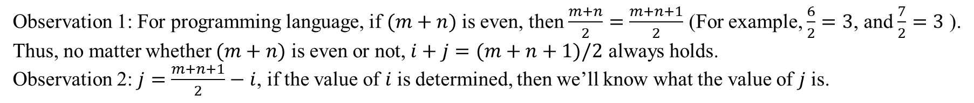
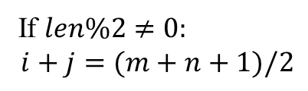




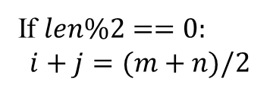



3rd solution: Array partitioning method
Determine the relationship between the upper bound $i$ and lower bound $j$. (The total length $len=m+n$)
$$i=4$$
$A_{1}:$
For $A_{1}$, $i=4$, $m=5$
If $len\%2==0:$
$$i+j=(m+n)/2$$
$A_{2}:$
For $A_{2}$, $j=2$, $n=7$
$$j=2$$
$$i=5$$
For $A_{1}$, $i=5$, $m=6$
If $len\%2≠0:$
$$i+j=(m+n+1)/2$$
$A_{1}:$
$A_{2}:$
For $A_{2}$, $j=2$, $n=7$
$$j=2$$
Observation 1: For programming language, if $(m+n)$ is even, then $\frac{m+n}{2}=\frac{m+n+1}{2}$ (For example, $\frac{6}{2}=3$, and $\frac{7}{2}=3$ ).
Thus, no matter whether $(m+n)$ is even or not, $i+j=(m+n+1)/2$ always holds.
Observation 2: $j=\frac{m+n+1}{2}−i$, if the value of $i$ is determined, then we’ll know what the value of $j$ is.
Notes:
划分边界线必须满足① 这个边界必须把两个数组划分为左右两个相等的部分，若总长度为奇数，则让左半部分多一个数。 ② 边界线左边的元素的值都比边界线右边的元素小

Slide 12
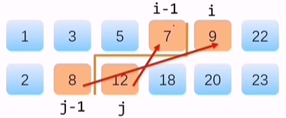
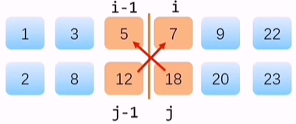
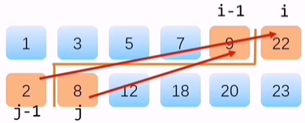
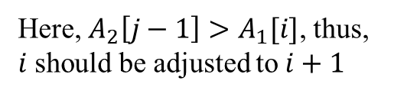
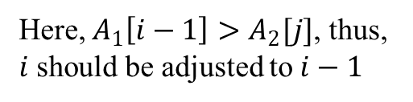
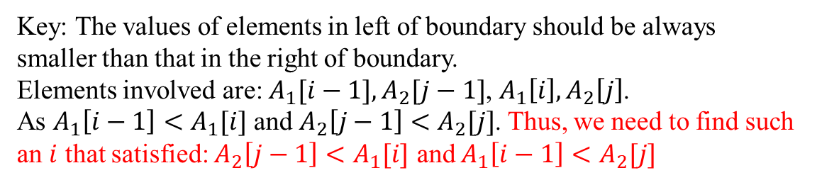
3rd solution: Array partitioning method
How to determine the value of $i$?
Key: The values of elements in left of boundary should be always smaller than that in the right of boundary.
Elements involved are: $A_{1}[i−1],A_{2}[j−1]$, $A_{1}\left[i\right],A_{2}\left[j\right]$.
As $A_{1}\left[i−1\right]<A_{1}[i]$ and $A_{2}\left[j−1\right]<$ $A_{2}[j]$. Thus, we need to find such an $i$ that satisfied: $A_{2}\left[j−1\right]<A_{1}[i]$ and $A_{1}\left[i−1\right]<A_{2}[j]$
Here, $A_{2}\left[j−1\right]>A_{1}[i]$, thus, $i$ should be adjusted to $i+1$
Here, $A_{1}\left[i−1\right]>A_{2}[j]$, thus, $i$ should be adjusted to $i−1$
Notes:
划分边界线必须满足① 这个边界必须把两个数组划分为左右两个相等的部分，若总长度为奇数，则让左半部分多一个数。 ② 边界线左边的元素的值都比边界线右边的元素小

Slide 13
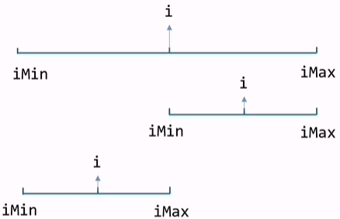
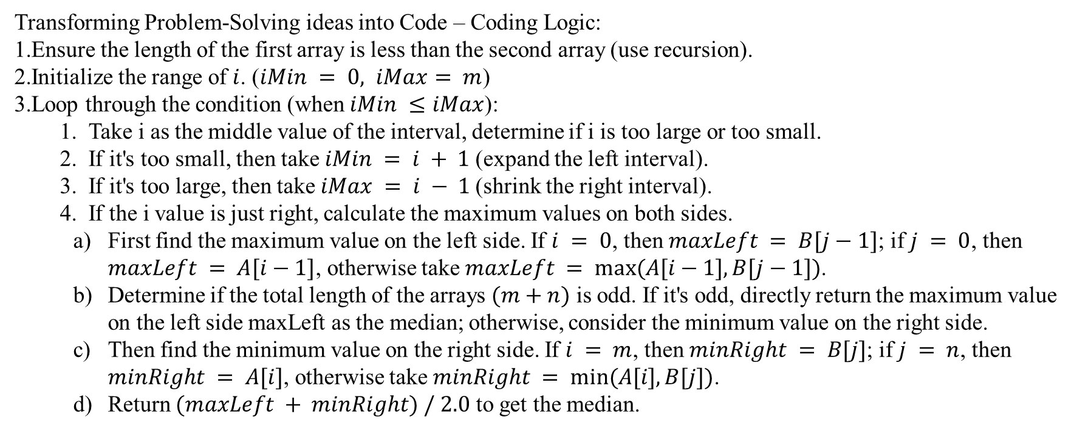
3rd solution: Array partitioning method
Transforming Problem-Solving ideas into Code – Coding Logic:
Ensure the length of the first array is less than the second array (use recursion).
Initialize the range of $i$. ($iMin = 0, iMax= m$)
Loop through the condition (when $iMin ≤iMax$):
Take i as the middle value of the interval, determine if i is too large or too small.
If it's too small, then take $iMin = i + 1$(expand the left interval).
If it's too large, then take $iMax = i − 1$(shrink the right interval).
If the i value is just right, calculate the maximum values on both sides.
First find the maximum value on the left side. If $i = 0$, then $maxLeft = B[j−1]$; if $j = 0$, then $maxLeft = A[i−1]$, otherwise take $maxLeft = max⁡(A[i−1], B[j−1])$.
Determine if the total length of the arrays $(m+n)$ is odd. If it's odd, directly return the maximum value on the left side maxLeft as the median; otherwise, consider the minimum value on the right side.
Then find the minimum value on the right side. If $i = m$, then $minRight = B[j]$; if $j = n$, then $minRight = A[i]$, otherwise take $minRight = min⁡(A[i], B[j])$.
Return $(maxLeft + minRight) / 2.0$ to get the median.
Notes:
划分边界线必须满足① 这个边界必须把两个数组划分为左右两个相等的部分，若总长度为奇数，则让左半部分多一个数。 ② 边界线左边的元素的值都比边界线右边的元素小
将上述思路转化成代码逻辑：
（1）确保第一个数组的长度小于第二个数组的长度。
（2）初始化i的范围。（iMin = 0, iMax = m）
（3）循环遍历条件 （当iMin <= iMax）:
i. 取i为中间值，判断i是否太大或者太小;
ii. 如果i太小，则令iMin = i + 1;
iii. 如果i太大，则令iMax = i – 1；
iv. 如果i的值正好合适，计算两边的最大值：
a) 首先找到左侧的最大值，如果 i = 0, 则maxLeft = B[j - 1]; 如果 j = 0, 则maxLeft = A[i – 1], 否则取 maxLeft = max(A[i - 1], B[j – 1])。
b) 判断两个数组的总长度(m+n)是否为奇数。如果是奇数，直接返回左侧最大值 maxLeft作为中位数。否则，考虑右侧的最小值。
c) 然后找到右侧的最小值，如果 i = m, 则 minRight = B[j]; 如果 j = n， 则 minRight = A[i], 否则取 minRight = min(A[i], B[j])。
d) 返回 (maxLeft + minRight) / 2.0 得到中位数。

Slide 14
3rd solution: Array partitioning method
Pseudo code by yourself
Notes:
划分边界线必须满足① 这个边界必须把两个数组划分为左右两个相等的部分，若总长度为奇数，则让左半部分多一个数。 ② 边界线左边的元素的值都比边界线右边的元素小

Slide 15

Q2
Design a divide-and-conquer algorithm for the following problem. Analyze the time complexity for your algorithm.
Input: An integer $x$ and an $m×n$ integer matrix $M$ such that $M_{i,j}<M_{i+1,j}$ and $M_{i,j}<M_{i,j+1}$ for all $i$ and $j$.
Question: Is $x$ is an element in $M$?

Slide 16
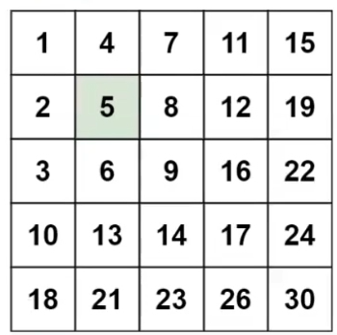
Think
Elements in this part are always smaller than 5.
Elements in this part are always bigger than 5

Slide 17
Q2
Pseudo Code?

Slide 18
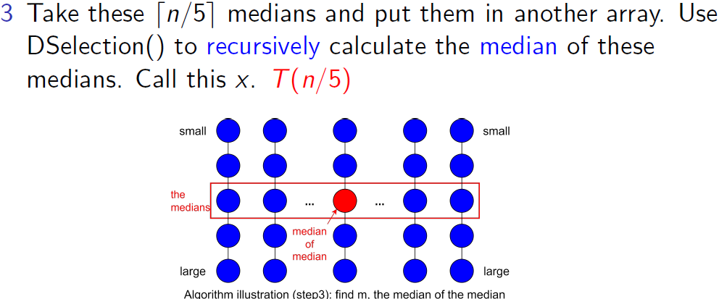
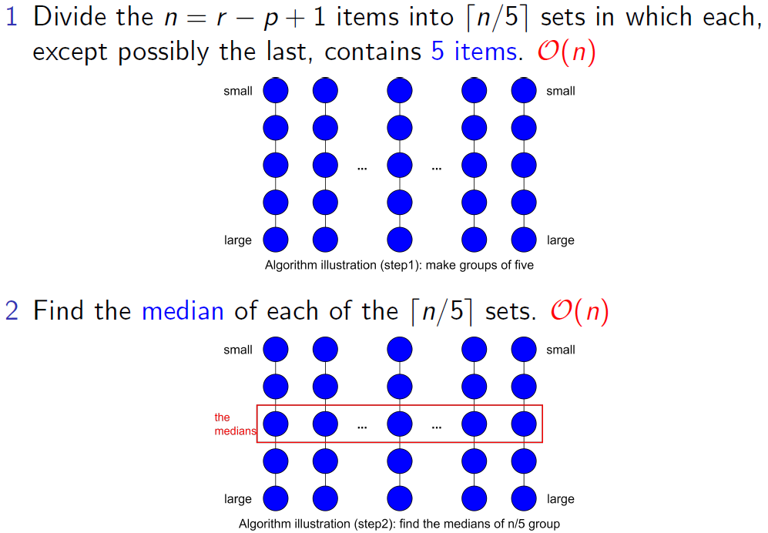
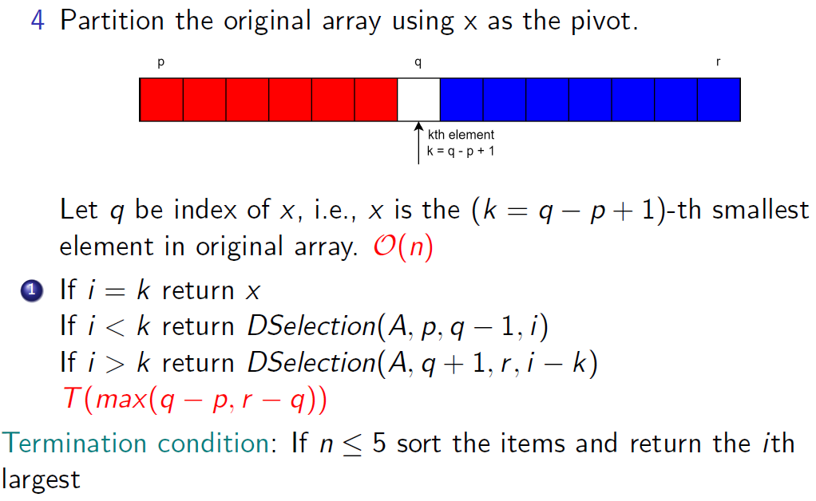
Lecture 5 Notes Explanation

Slide 19
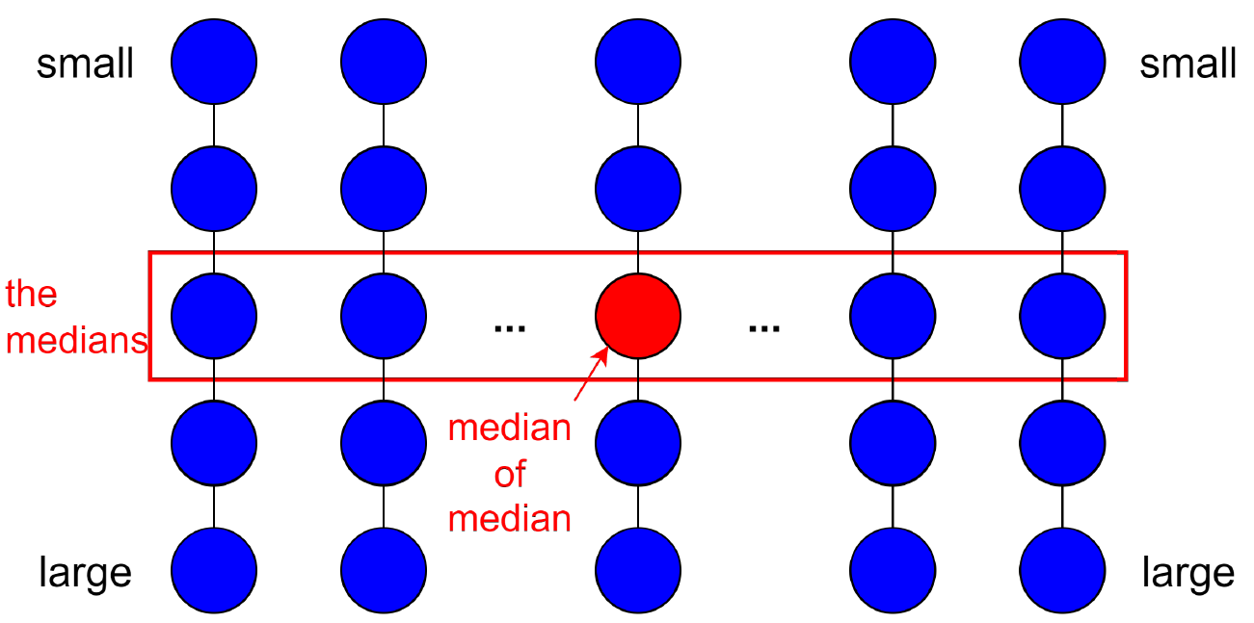
Lecture 5 Notes Explanation
How to compute it?

Slide 20
Lecture 5 Notes Explanation
How to compute it?
medians
S

Slide 21
Reference
LeetCode004

